Slide 1
A Study Of The Book Of Revelation
August 2, 2020

Slide 2
Revelation 3:7-13
“Letter to the Church at Philadelphia”
The Church That Was Faithful
Identification of the author (verse 7)
Commendation (verses 8-11)
Promise if they overcome (verses 12-13)

Slide 3
Letters To Seven Churches of Asia
(Revelation 2-3)
Some were good (Smyrna, Philadelphia)
Some were good / bad (Ephesus, Pergamum, Thyatira, Sardis)
One was bad (Laodicea)

Slide 4
Letters To Seven Churches of Asia
(Revelation 2-3)
Good
Good/
Bad
Good
Good/
Bad
Bad
Good/
Bad
Good/
Bad
Most of us would like to be in GOOD church (no condemnation)
None of us would have anything to do with a BAD church (no commendation)
Reality: may be in a church that is GOOD / BAD (Some commendation and some condemnation)

Slide 5
The Church At Philadelphia
(Revelation 3:7-13)
Get a letter – You’ve done great, so keep on!
You have promise and opportunity.
A Church That Was Faithful “Church with an Open Door”
Dear Philadelphia,
I know your works.

Slide 6
Revelation 3:7-13
P
H
I
L
A
D
E
L
P
H
I
A
28 miles SE of Sardis
Dates back 159 BC
Named after King Attalus II Philadelphus, of Pergamum (159-138 BC). Named the city out of affection for his brother Ecumenus II
“Missionary” city – for the purpose of spreading Greek culture and language.

Slide 7
Revelation 3:7-13
P
H
I
L
A
D
E
L
P
H
I
A
Youngest of the 7 cities. Famous for wines – the city’s coins displayed an image of the “god of wine.”
Near the greatest highway in the world – the highway from Europe to the Eastern gateway.
Most favorable for commercial and strategically purposes
Center of much heathen worship
Many temples to heathen gods – “Little Athens”

Slide 8
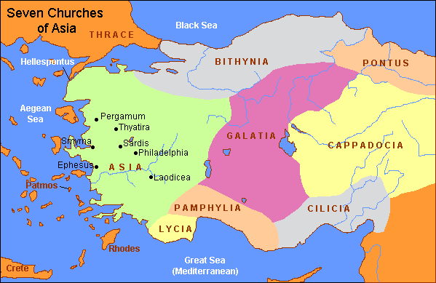

Slide 9
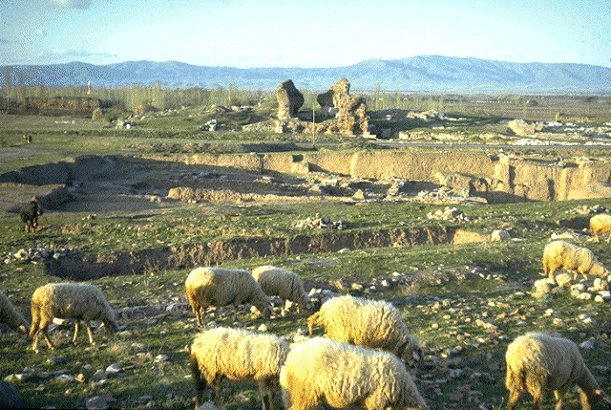
Albert Barnes notes, “The country, as viewed from these hills, is extremely magnificent – gardens and vineyards lying at the back and sides of the town, and before it one of the most beautiful and extensive plains of Asia.”
Barnes, Albert, Barnes on the New Testament, “Revelation” Volume 11, Page 92.

